Slide 1
Chapter 9:
Using Classes and Objects

Slide 2
Objectives
Learn about class concepts.
Create classes from which objects can be instantiated.
Create objects.
Create properties, including auto-implemented properties.
Learn more about using public and private access modifiers.
Learn about the this reference.

Slide 3
Objectives
Write and use constructors.
Use object initializers.
Overload operators.
Declare an array of objects and use the Sort() and BinarySearch() methods with them.
Write destructors.
Understand GUI application objects.

Slide 4
Understanding Class Concepts
When you write programs in C#, you create two types of classes:
Classes that are only application programs with a Main() method.
Classes from which you instantiate objects.
Can contain a Main() method, but it is not required
When you think in object-oriented manner, everything is an object, and an object is an instance of a class.
In other words, every object is a member of a more general class.

Slide 5
Understanding Class Concepts
An object is an instantiation of a class
The data components of a class that differ for each object are stored in instance variables (also called fields).
They help distinguish themselves from other variables you might use in a program.
The set of contents of an object’s instance variables are also known as its State.

Slide 6
Understanding Class Concepts
Methods associated with objects are called instance methods.
Every instance of a class has the same methods available to it as the original.
A program or class that instantiates objects of another prewritten class is a class client or class user.

Slide 7
Creating a Class from Which Objects Can Be Instantiated
The parts of a class header or class definition.
An optional access modifier (default is internal).
The keyword class.
Any legal identifier for the name of your class.
The keyword internal is an example of a class access modifier. Others class access modifiers are:
public
protected
private

Slide 8
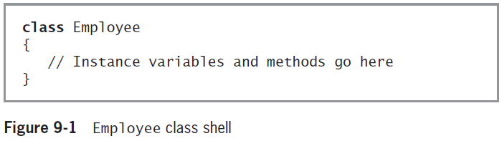
Creating a Class from Which Objects Can Be Instantiated

Slide 9
Creating Instance Variables and Methods
When creating a class, you define both its attributes and its methods.
The allowable field access modifiers are new, public, protected, internal, private, static, readonly, and volatile.
Most class fields are nonstatic and private, which means that no other class can access the field’s values, and only nonstatic methods of the same class will be allowed to set, get, or otherwise use the field.

Slide 10
Creating Instance Variables and Methods
Using private fields within classes is an example of information hiding, a feature found in all object-oriented languages.
Most class methods are public.
The private data fields and public method arrangement allows you to control outside access to your data.

Slide 11
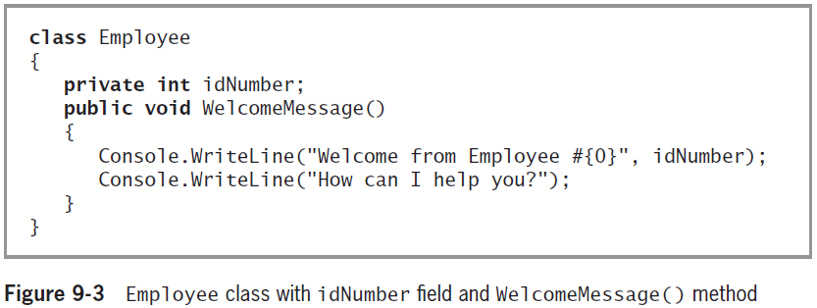
Creating Instance Variables and Methods
Using an object within another object is known as composition.
The relationship created is also called a has-a relationship because one class “has an” instance of another.

Slide 12
Creating Objects
Declaring a class does not create any actual objects.
A class is just an abstract description of what an object will be like if any objects are actually instantiated.
The two-step process to create an object:
Supply a type and an identifier.
Create the object, which allocates memory for it.
A reference type is an identifier for an object that references its memory address.
When you create an object, you call its constructor, which has the same name as the class whose objects it constructs.

Slide 13
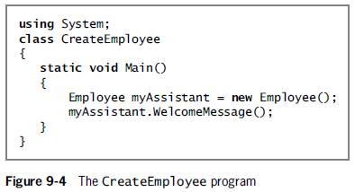
Creating Objects

Slide 14
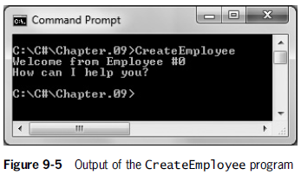
Creating Objects

Slide 15
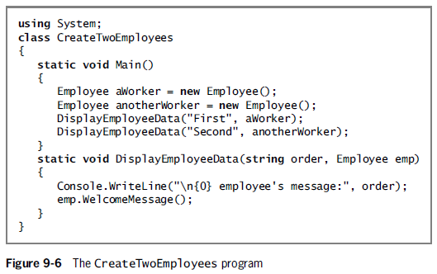
Passing Objects to Methods
You can pass objects to methods just as you can simple data types.

Slide 16
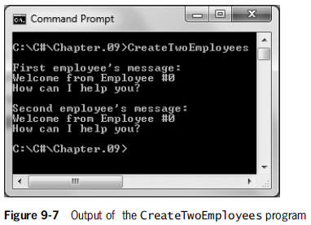
Passing Objects to Methods

Slide 17
Creating Properties
A property is a member of a class that provides access to a field of a class.
Properties define how fields will be set and retrieved.
Properties have accessors that specify the statements that execute when a class’s fields are accessed.
set accessors are used for setting an object’s fields.
get accessors are used for retrieving the stored values.
The field that supports a property is its backing field.

Slide 18
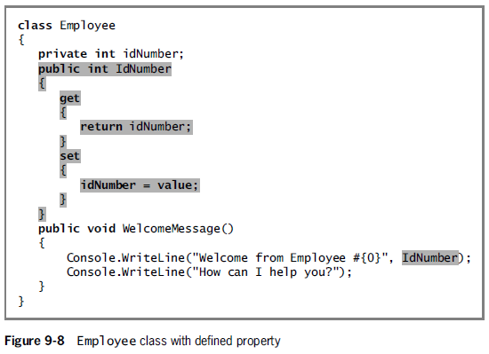
Creating Properties
When a property has only a get accessor (and not a set accessor), it is a read-only property.
In C#, the get and set accessors often are called the getter and the setter, respectively.

Slide 19
Creating Properties
Contextual keywords are identifiers that act like keywords in specific circumstances. There are six of them:
get, set, value, partial, where, and yield
An implicit parameter is one that is undeclared and that gets its value automatically.

Slide 20
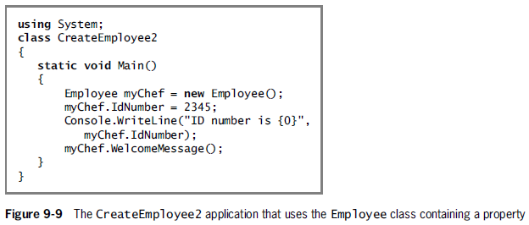
Creating Properties

Slide 21
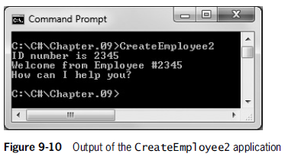
Creating Properties

Slide 22
Using Auto-Implemented Properties
When a property is written as an auto-implemented property, the property’s implementation (its set of working statements) is created for you automatically with the assumption that:
The set accessor should simply assign a value to the appropriate field.
The get accessor should simply return the field.
When you use an auto-implemented property, you do not need to declare the field that corresponds to the property.

Slide 23
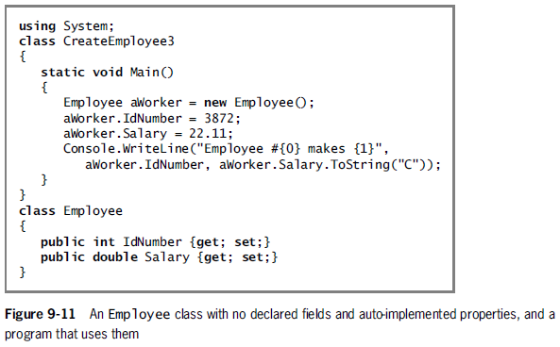
Using Auto-Implemented Properties

Slide 24
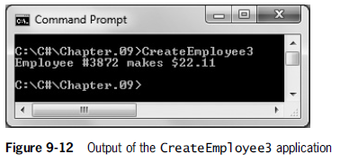
Using Auto-Implemented Properties

Slide 25
More About public and private Access Modifiers
Occasionally, you need to create public fields or private methods.
You create a public data field when you want all objects of a class to contain the same value.
A named constant within a class is always static and it belongs to the entire class, not to any particular instance.

Slide 26
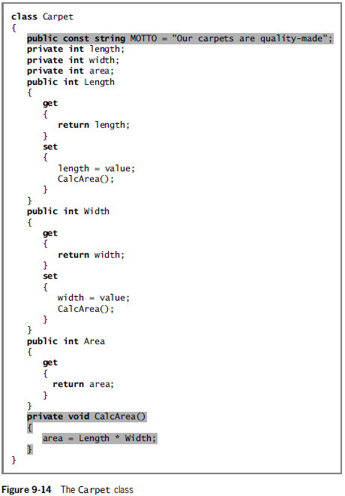

Slide 27
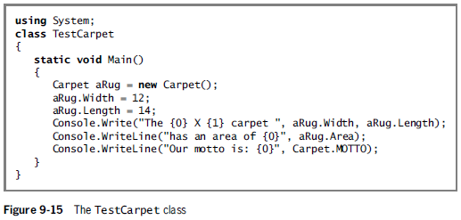
More About public and private Access Modifiers

Slide 28
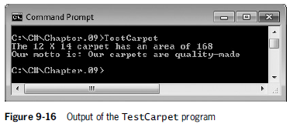
More About public and private Access Modifiers

Slide 29
Understanding the this Reference
When you create a class, only one copy of the class code is stored in computer memory.
However, you might eventually create thousands of objects from a class.
Each object does not need to store its own copy of each property and method.
The this reference refers to an implicitly passed reference and it is the address of the invoking object.
When you call a method, you automatically pass the this reference to the method – which tells the method which instance of the class to use.

Slide 30
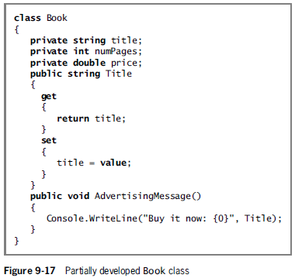
Understanding the this Reference

Slide 31
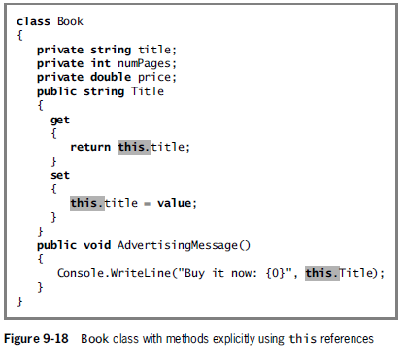
Understanding the this Reference

Slide 32
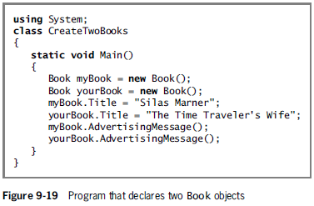
Understanding the this Reference

Slide 33
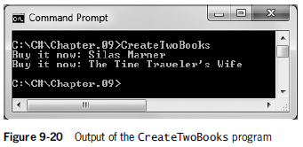
Understanding the this Reference

Slide 34
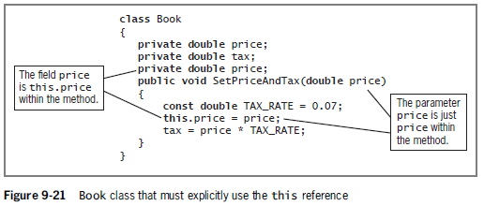
Understanding the this Reference
Sometimes you must explicitly code the this reference

Slide 35
Understanding Constructors
A constructor is a method that instantiates (creates an instance of) an object.
A default constructor is an automatically supplied constructor without parameters.
The default value of the object is the value given to an object initialized with a default constructor.

Slide 36
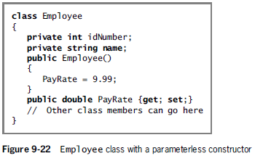
Passing Parameters to Constructors
A parameterless constructor is a constructor that takes no arguments.
A class can only contain one parameterless constructor.

Slide 37
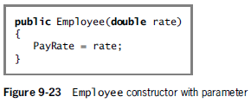
Passing Parameters to Constructors
You can also create a constructor that receives an argument or arguments.

Slide 38
Overloading Constructors
C# automatically provides a default constructor for classes that you create.
As soon as you create a constructor on your own, whether it has parameters or not, you no longer have access to the automatically created version.
Like any other C# methods, constructors can be overloaded.
You can write as many constructors as you want, as long as their argument lists do not cause ambiguity.

Slide 39
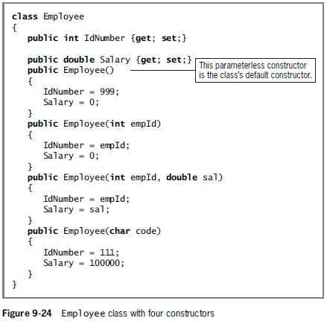

Slide 40
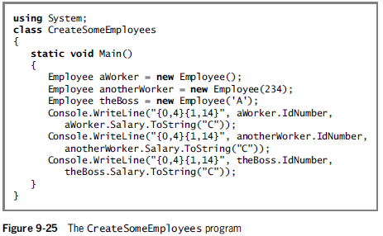
Overloading Constructors

Slide 41
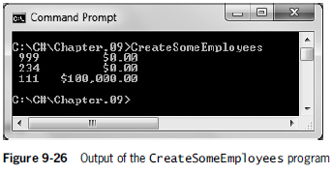
Overloading Constructors

Slide 42
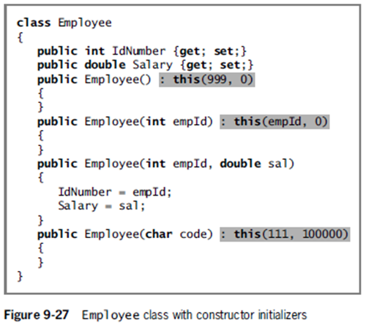
Using Constructor Initializers
A constructor initializer is a clause that indicates another instance of a class constructor should be executed before any statements in the current constructor body.

Slide 43
Using the readonly Modifier in a Constructor
The readonly modifiers are like named constants in that they are assigned a value that cannot be changed.
Their value can be assigned at run time rather than at compile time.
They can get their value from user input or the operating system.

Slide 44
Using Object Initializers
An object initializer allows you to assign values to any accessible members or properties of a class at the time of instantiation without calling a constructor with parameters.
In order to use object initializers, a class must have a default constructor.
That is, you either must not create any constructors or you must create one that requires no parameters.

Slide 45
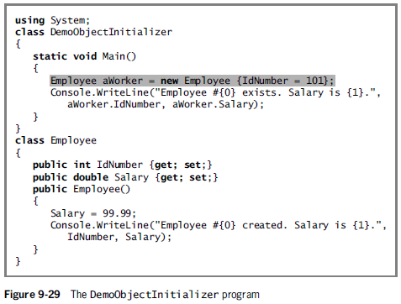
Using Object Initializers

Slide 46
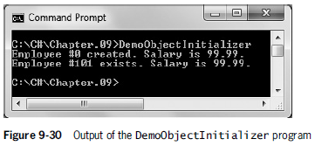
Using Object Initializers

Slide 47
Using Object Initializers
Using object initializers allows you to:
Create multiple objects with different initial assignments without having to provide multiple constructors to cover every possible situation.
Create objects with different starting values for different properties of the same data type.

Slide 48
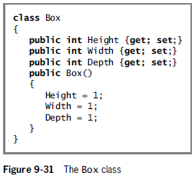
Using Object Initializers

Slide 49
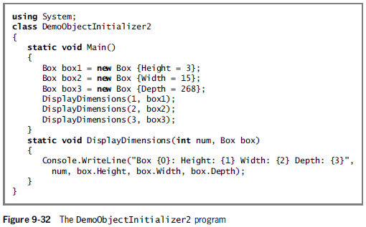
Using Object Initializers

Slide 50
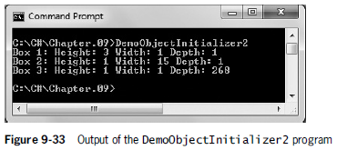
Using Object Initializers

Slide 51
Overloading Operators
Overloading operators
Enables you to use arithmetic symbols with your own objects
Overloadable unary operators:
+ - ! ~ ++ -- true false
Overloadable binary operators:
+ - * / % & | ^ == != > < >= <=
You cannot overload the following operators:
= && || ?? ?: checked unchecked new typeof as is
You cannot overload an operator for a built-in data type

Slide 52
Overloading Operators
When a binary operator is overloaded and has a corresponding assignment operator, it is also overloaded
Some operators must be overloaded in pairs:
== with !=, and < with >
Syntax to overload unary operators:
type operator overloadable-operator (type identifier)
Syntax to overload binary operators:
type operator overloadable-operator (type identifier, type operand)

Slide 53
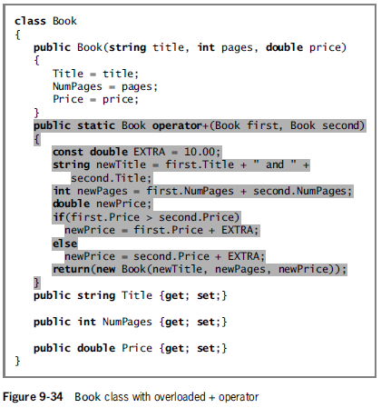

Slide 54
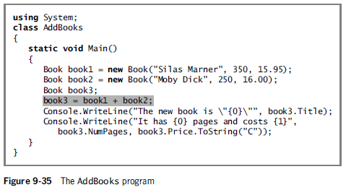
Overloading Operators

Slide 55
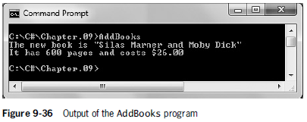
Overloading Operators

Slide 56
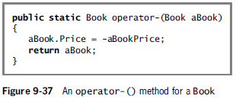
Overloading Operators
Overloaded unary operators take a single argument.

Slide 57
Declaring an Array of Objects
Just as you can declare arrays of integers or doubles, you can declare arrays that hold elements of any type, including objects.
Example:
Employee[] empArray = new Employee[7];
for(int x = 0; x < empArray.Length; ++x)
empArray[x] = new Employee();

Slide 58
Using the Sort() and BinarySearch() Methods with Arrays of Objects
The CompareTo() method provides the details of how the basic data types compare to each other.
The Sort() and BinarySearch() methods use the CompareTo() method for the current type of data being sorted.
When you create a class that contains many fields, tell the compiler which field to use when making comparisons by using an interface.

Slide 59
Using the Sort() and BinarySearch() Methods with Arrays of Objects
An interface is a data type, and is a collection of methods that can be used by any class as long as the class provides a definition to override the interface’s do-nothing, or abstract, method definitions.
When a method overrides another, it takes precedence, hiding the original version.
An IComparable interface contains the definition for the CompareTo() method that compares one object to another and returns an integer.

Slide 60
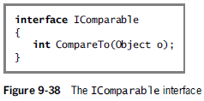
Using the Sort() and BinarySearch() Methods with Arrays of Objects

Slide 61
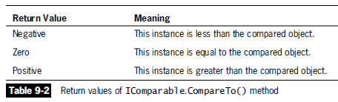
Using the Sort() and BinarySearch() Methods with Arrays of Objects

Slide 62
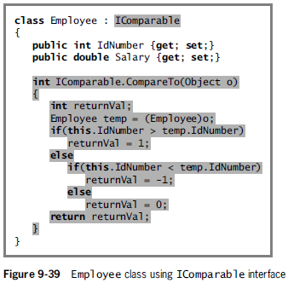
Using the Sort() and BinarySearch() Methods with Arrays of Objects

Slide 63
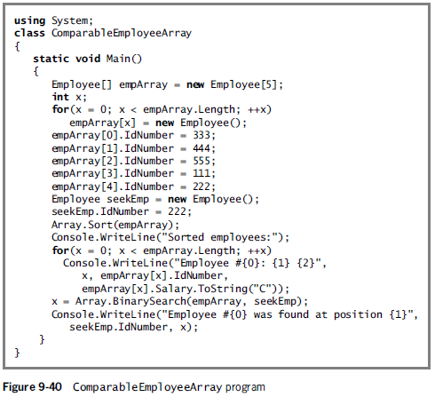
Using the Sort() and BinarySearch() Methods with Arrays of Objects

Slide 64
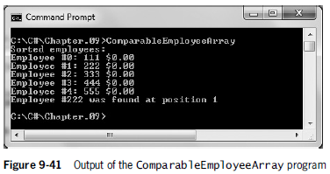
Using the Sort() and BinarySearch() Methods with Arrays of Objects

Slide 65
Understanding Destructors
A destructor contains the actions you require when an instance of a class is destroyed.
Most often, an instance of a class is destroyed when it goes out of scope.
To explicitly declare a destructor, use an identifier that consists of a tilde (~) followed by the class name.

Slide 66
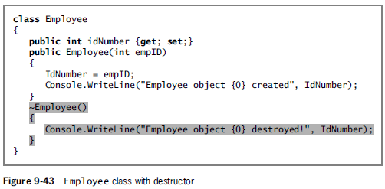
Understanding Destructors

Slide 67
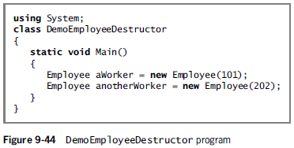
Understanding Destructors

Slide 68
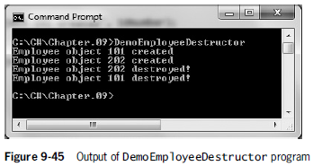
Understanding Destructors

Slide 69
Understanding GUI Application Objects
Objects you have been using in GUI applications, such as Forms, Buttons, and Labels, are objects that are like others you have learned about in this chapter.
That is, they encapsulate properties and methods.
When you start a Windows Forms application in the IDE and drag a Button onto the form, a statement is automatically created to instantiate a Button object.

Slide 70
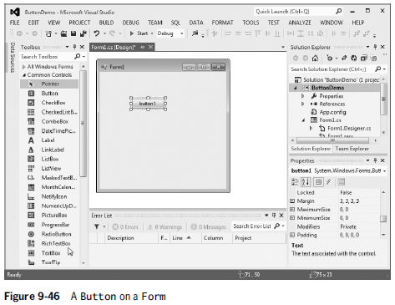
Understanding GUI Application Objects

Slide 71
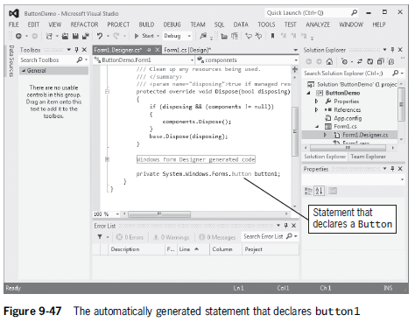
Understanding GUI Application Objects

Slide 72
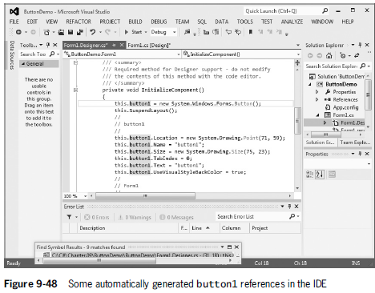
Understanding GUI Application Objects

